Slide 1
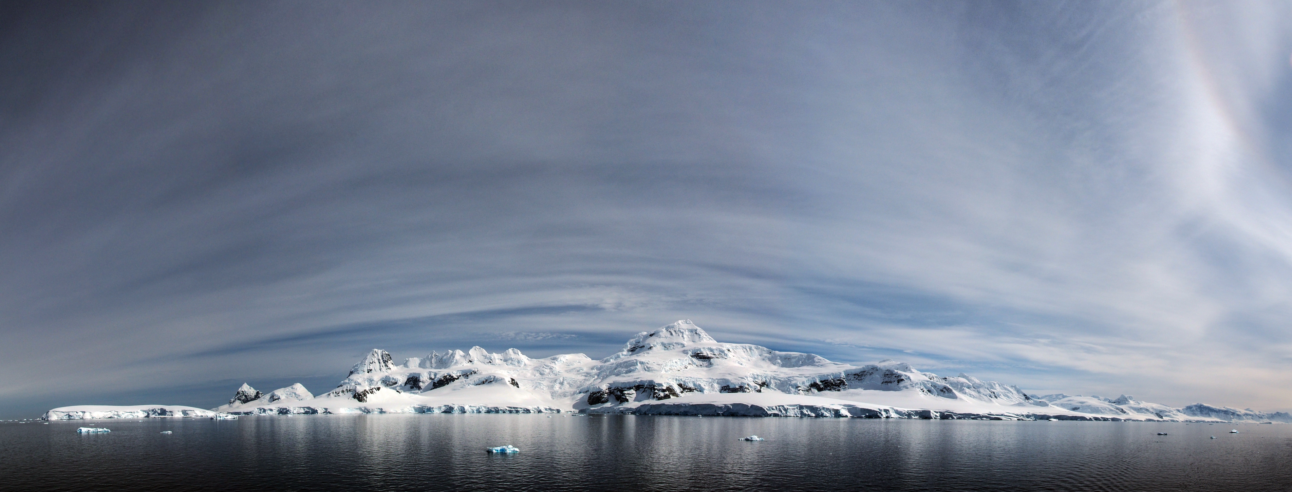
Bayesian data-model synthesis for biological conservation and management in Antarctica
Award: NNX14AC32G
PI: Dr. Heather J. Lynch (Stony Brook University)
Co-I: Dr. Mathew Schwaller (NASA Goddard)
Partner Organization: Oceanites, Inc.
Additional project participants from Stony Brook University: Kevin Shoemaker, Philip McDowall, Casey Youngflesh, Maureen Lynch, Michael Schrimpf, Catherine Foley

Slide 2
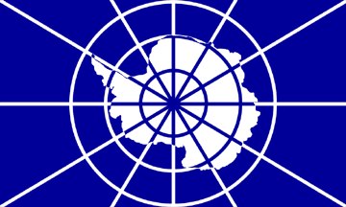
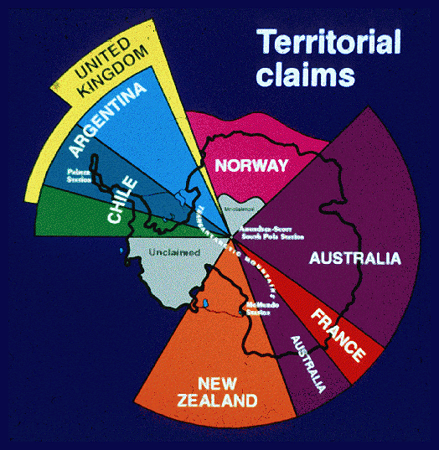
Antarctic management complicated by data scarcity and consensus-based decision making
Antarctic Treaty System
29 consultative (voting) Parties
23 non-consultative (non-voting) Parties
NSF
Convention for the Conservation of Antarctic Marine Living Resources (CCAMLR)
25 voting member nations
8 non-voting Parties

Slide 3
Baseline decision-making capacity within the Antarctic Treaty System is weak
From a review of Antarctic management plans and environmental impact assessments
Quantitative data
Census date included
Source for census data
Peer-reviewed source
Trend data
 | 60.7% | 53.9% | 30.3% | 14.6% | 11.2%
Lynch et al. In Review at Antarctic Science

Slide 4
The mission: To create a publicly-accessible, easy-to-use, browser-based application that provides Antarctic biodiversity data (abundance, trends, forecasts) at any user-defined spatial and temporal scale
How do we do this? By leveraging recent developments in remote sensing that have radically expanded the opportunities for regular, high-quality biological surveys (of seabirds and seals) at the continental scale.
NASA
Commercial
Landsat-4
30m multispectral
Landsat-5
30m multispectral
Landsat-7
15m panchromatic
30m multispectral
Landsat-8
15m panchromatic
30m multispectral
Quickbird
2.4m multispectral)
0.6m panchromatic
Worldview-1
0.5m panchromatic
Worldview-2
1.6m multispectral
0.4m panchromatic
Geoeye
1.6m multispectral
0.4m panchromatic
IKONOS
4m multispectral
1m panchromatic
Worldview-3
1.24m multispectral
0.31m panchromatic
Merger of commercial and NASA satellite imagery products
Chinstrap penguin colony
in Quickbird imagery

Slide 5
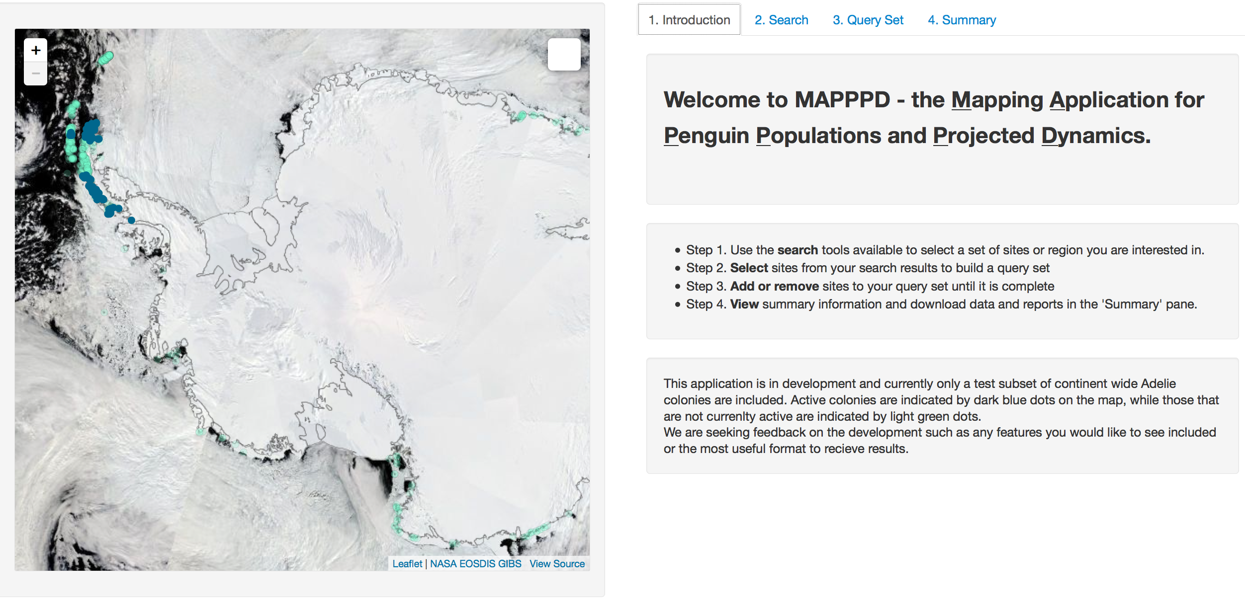
‘MAPPPD’ Mapping Application for Penguin Populations and Projected Dynamics
Regular, continental-scale monitoring of Antarctic biodiversity requires:
sensor-specific retrieval and interpretation algorithms
models for data integration
Getting those data into the policy process requires:
easy-to-use data + model output application for stakeholders

Slide 6
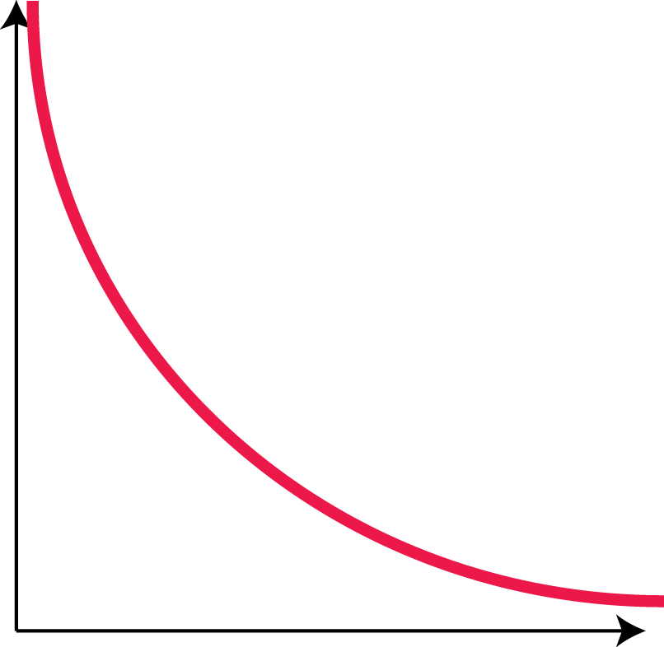
MAPPPD integrates the ‘long-tail’ of data while creating a
pipeline of remote sensing based population data for
decision support and management
New: Remote sensing
Data size
Scientific literature
Gray literature & unpublished data
Number of data sources

Slide 7
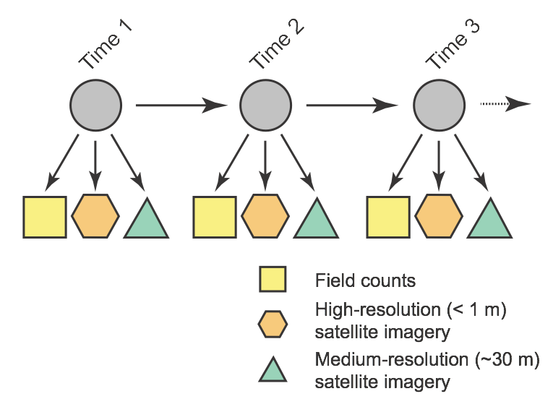
How MAPPPD works on the inside
Dynamic Naive Bayesian Network Model
Time
Independent
Observations
Conditional
relationships
True (latent) state
Multiple observations
that reflect that true state

Slide 8
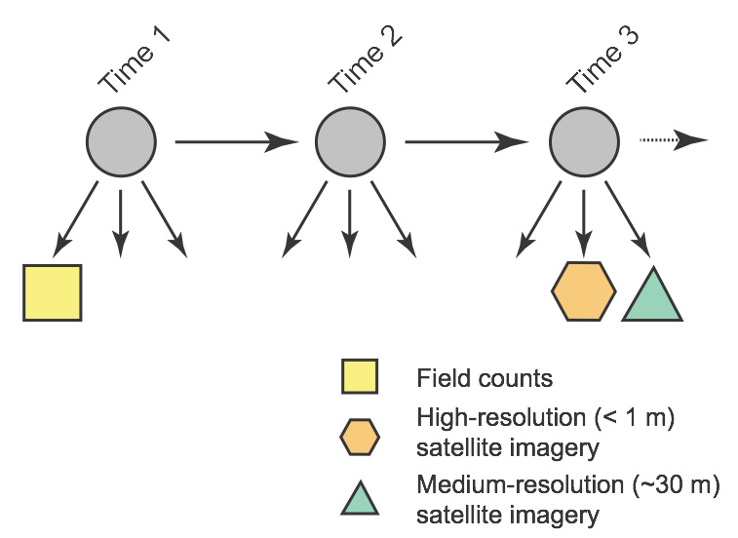
How MAPPPD works on the inside
Dynamic Naive Bayesian Network Model
Time
Independent
Observations
Conditional
relationships
True (latent) state
Multiple observations
that reflect that true state

Slide 9
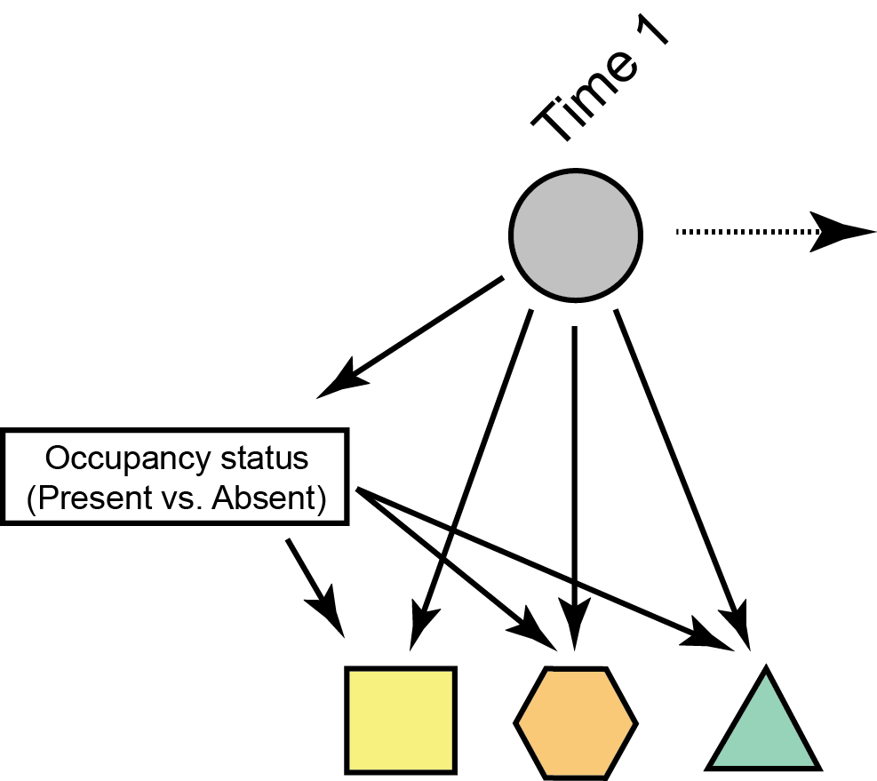
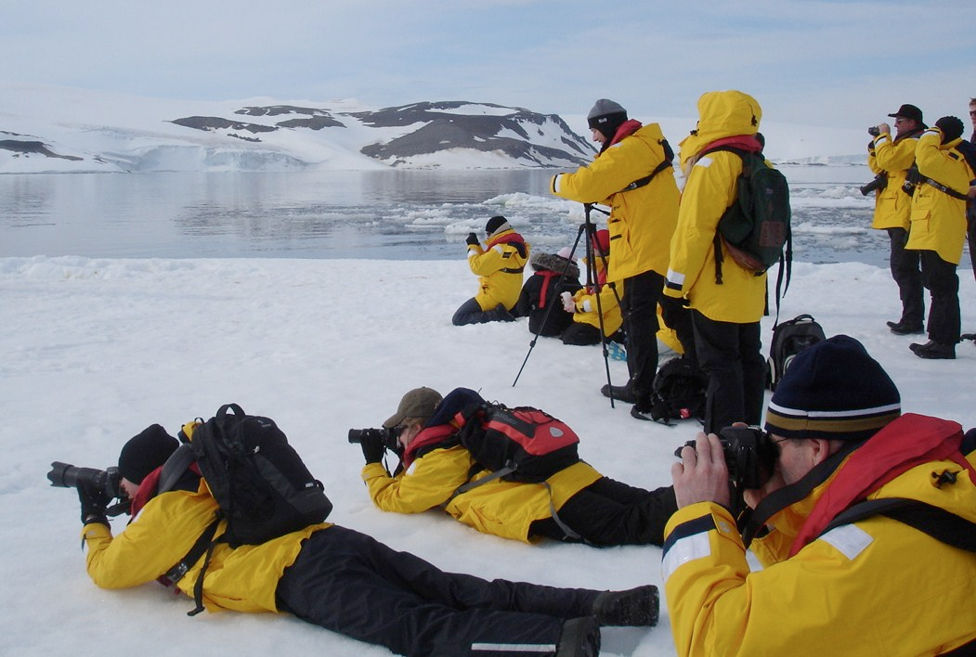
How MAPPPD works on the inside
Dynamic Naive Bayesian Network Model
Time
Independent
Observations
Conditional
relationships
Photo: A. Shaik
Citizen science
Presence/Absence data

Slide 10
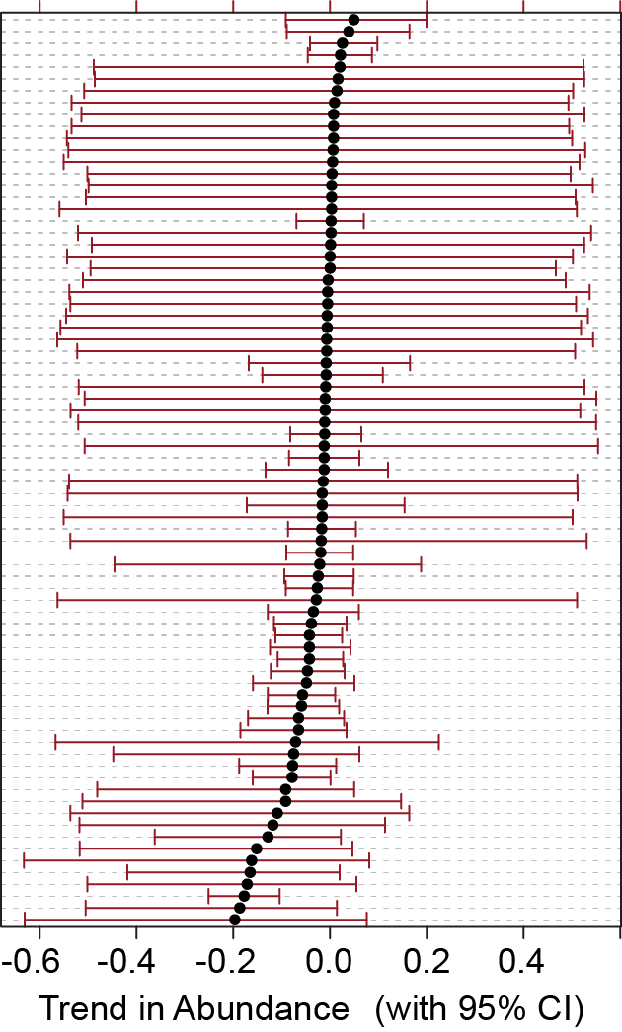
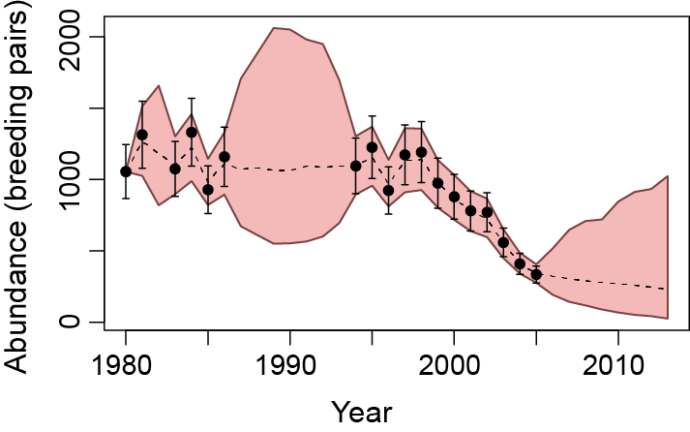
DNBN method allows us to get abundance and trends at individual populations for any user-defined area
Uncertainly balloons in years with no data
Ardley Island
Sites

Slide 11
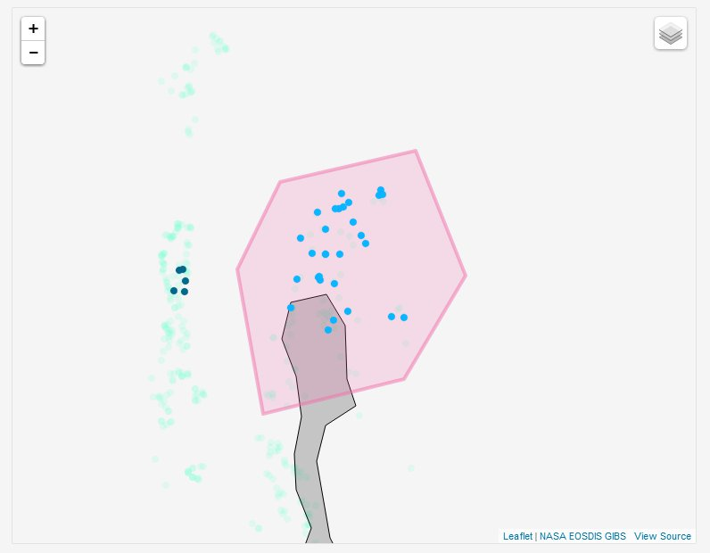
How MAPPPD works on the outside
1
Create your own area of interest or upload a shapefile.

Slide 12
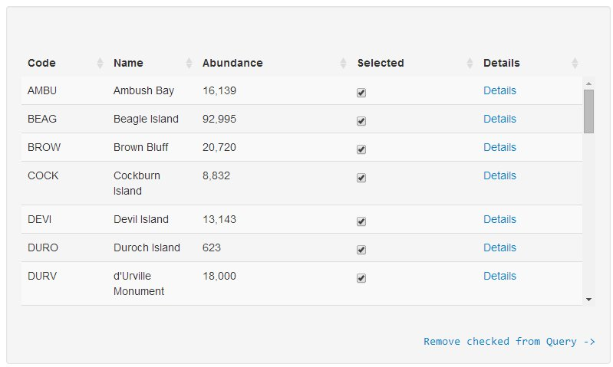
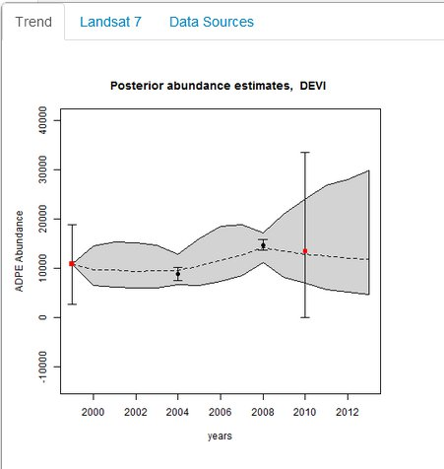
2
Add sites of interest to a query set.
Details: All the underlying data
with citations  provides a
pathway for transparent citation
and sourcing of survey data
3
Plot past trends and predicted future dynamics as generated from the DBN model.

Slide 13
4
Download summary data on total abundance and (in the future) future predicted dynamics.

Slide 14
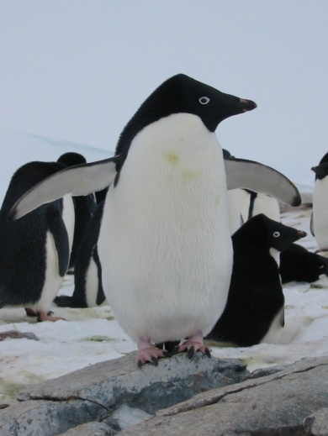
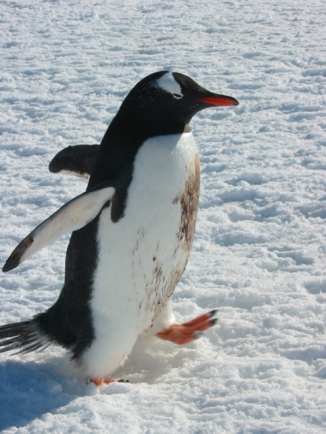
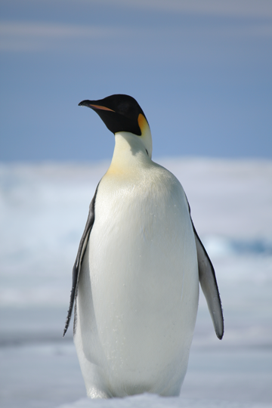
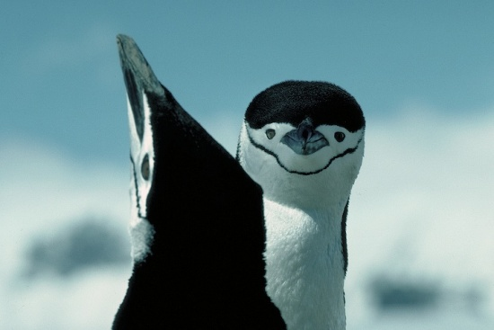
What lies ahead?
Development of a radiative transfer model
Landsat-4, -5, -7 cross-calibration algorithm
Development of a suite of seabird indicators for the Southern Ocean
Completion of the DBN model using all Antarctic sites
Creation of an Antarctic spectral library
Integration of three additional penguin species
+

Slide 15
Bringing in ‘dark’ data
Cape Hallet
12/14/1983
Scale 1:6000

Slide 16
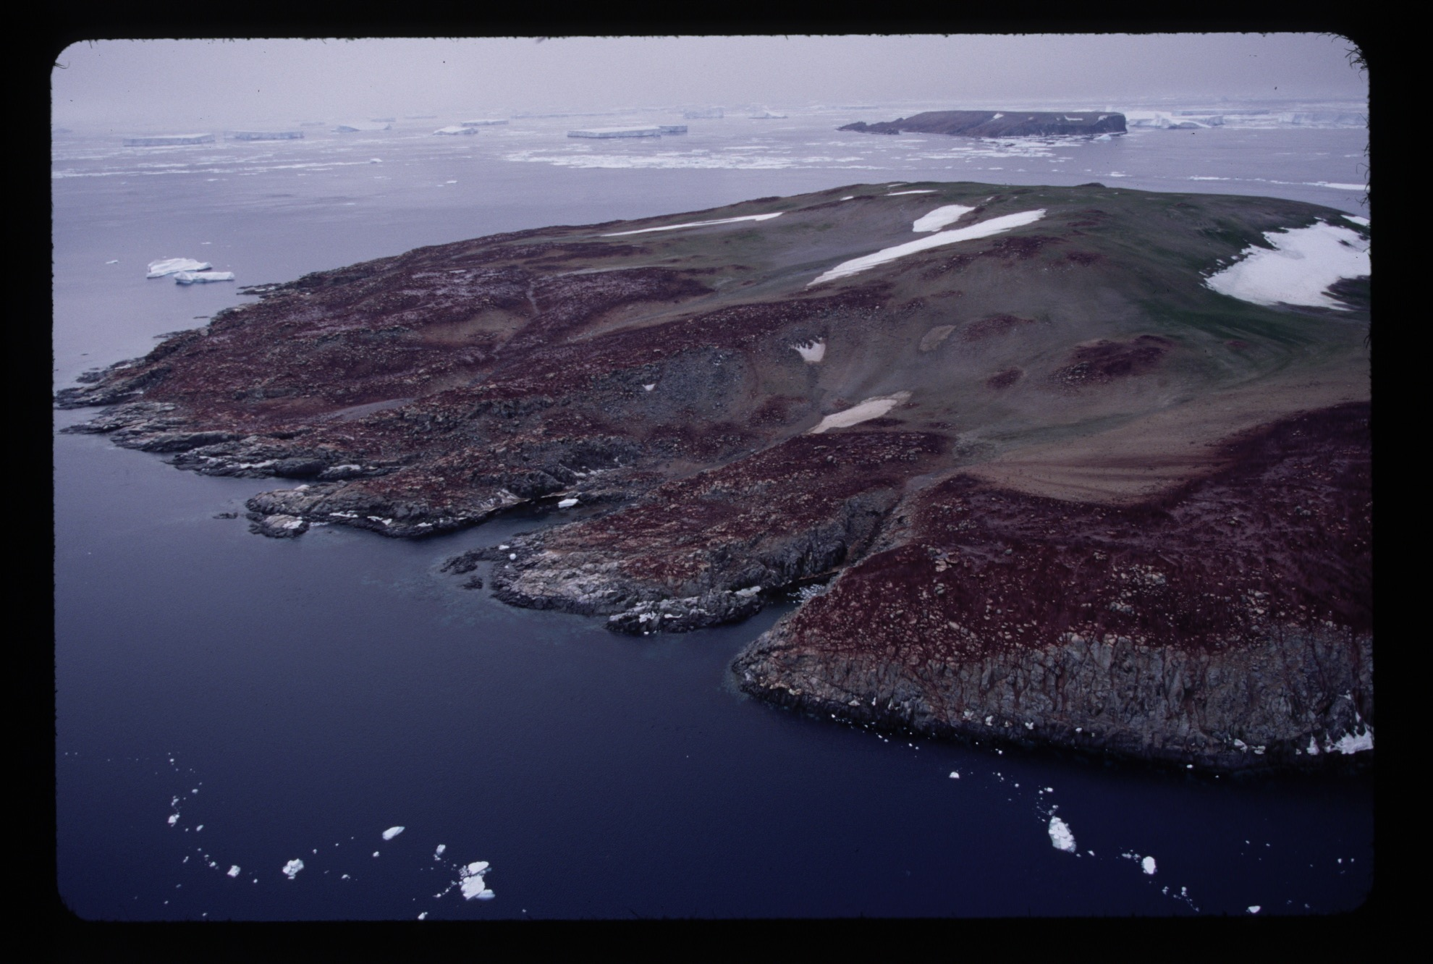
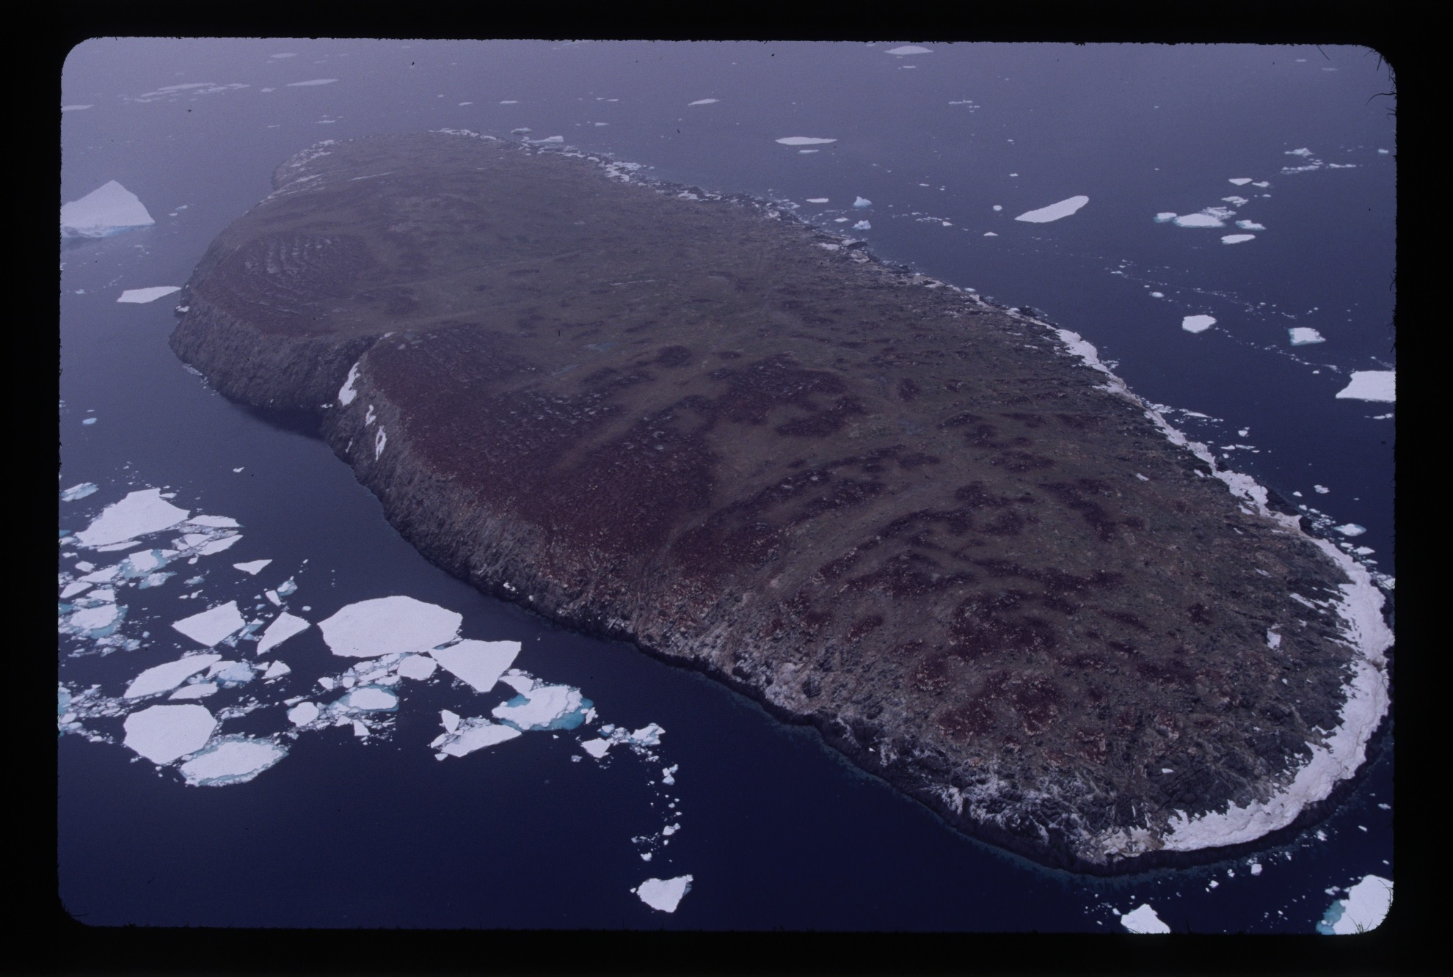
Collecting new data:
Danger Islands Expedition January 2016
Funding provided by the Dalio Foundation
Some populations known only from helicopter survey - the rest
discovered by Landsat imagery

Slide 17
Support provided by NASA NNX14AC32G
Questions?

